Slide 1
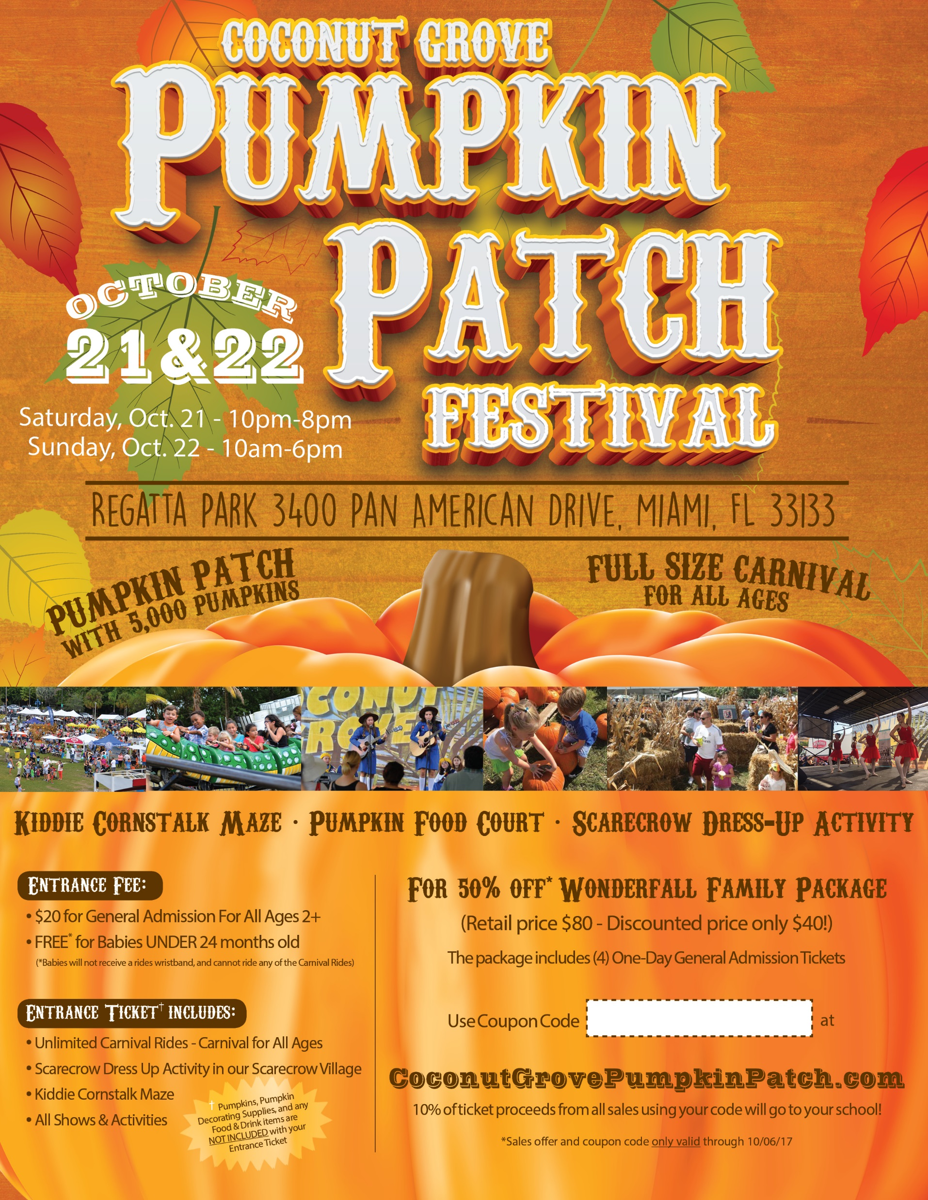
Coconut Grove pumpkin Patch Festival simple fundraising program
Post digital flyer on your school website and/or email it directly to parents.
Families go online to the Festival website to purchase event tickets and use YOUR school’s customized coupon code.
Coupon code is valid through October 6, 2017.
With your custom coupon code, families receive 50% OFF a “WonderFALL Family Package”, good for four (4) 1-Day General Admission Entrance Tickets to the festival.
Retail package price: $80.00; Discounted price: $40.00
Each package purchased using your school’s coupon code will earn your school 10% of the ticket proceeds ($4.00 per package sold).
5. We’ll track all the online sales with your code. Once the campaign is over, the Coconut Grove Pumpkin Festival will send you a check for the TOTAL amount raised for your school!
ALL YOU HAVE TO DO IS POST THE FLYER ON YOUR SCHOOL WEBSITE, AND WE DO THE REST!
CUSTOM CODE

Slide 2
Coconut Grove pumpkin Patch Festival partnership Participation form
To confirm your participation, please fill out this form and send it to Carolina@promomoxie.com.
School Information
School Name: _________________________ Phone: ______________________
Address: __________________________________________________________
City: _____________________State: _______ Zip Code: ___________________
School Website Address: _____________________________________________
Personal Information
Contact Name: ____________________________________________________
Title: ____________________________________________________________
Phone: __________________________________________________________
Email: ___________________________________________________________
Additional Information
1.) How many students are currently attending your school? _______________
Please feel free to contact us with any questions or concerns.
Looking forward to working with you!
Carolina Sanchez
Coconut Grove Pumpkin Patch Festival
Phone: 954-530-0350; Fax: 786-513-2340 carolina@promomoxie.com

